Slide 1

Introduction Data-X: A Course on Data, Signals, and Systems
Data ^{X}
About Me:
Ikhlaq Sidhu Chief Scientist & Founding Director, Sutardja Center for Entrepreneurship & Technology IEOR Emerging Area Professor Award, UC Berkeley

Slide 2
A High Level Overview of Data

Slide 3
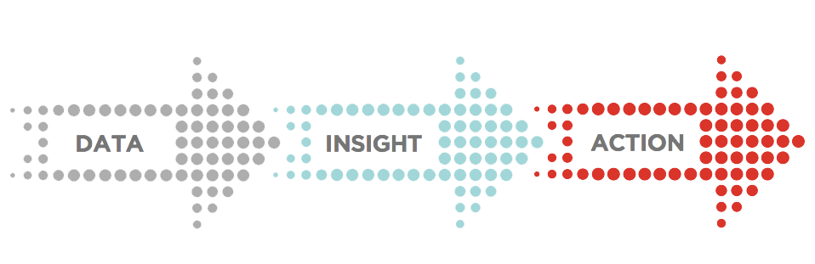
Basic Concept of Working with Data
Data Wrangling
In Production

Slide 4



Human Interpretation of Data
Large Sets of Data
Human
Insight
Machines

Slide 5
How did data become such a big deal?

Slide 6

Model Examples for things that normally require human judgment
Scoring Wine
Wine quality =
12.145 +
0.00117 x (winter rainfall ) +
0.0614 x (average growing season temperature) –
0.00386 x (harvest rainfall)
Oren Ashenfelter, Princeton. Now used by Christies Auction House

Slide 7
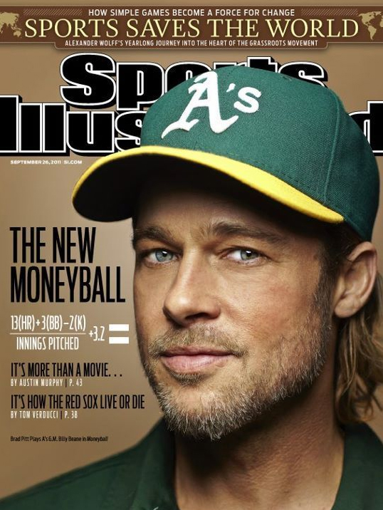
Competitive Advantage in Sports
Money Ball:
How to measure and predict baseball performance
Oakland Athletics baseball team and its general manager Billy Beane
A: Watch and talk with hundreds of players
B: Runs created =
(hits + walks) x Total Bases /
(At Bats + Walks)
Now: Basketball, Football, and soon every other sport
Notes:
Moneyball: The Art of Winning an Unfair Game is a book by Michael Lewis, published in 2003, about the Oakland Athletics baseball team and its general manager Billy Beane. Its focus is the team's analytical, evidence-based, sabermetric approach to assembling a competitive baseball team, despite Oakland's disadvantaged revenue situation. A film based on the book starring Brad Pitt was released in 2011.
Synopsis[edit source | editbeta]
The central premise of Moneyball is that the collected wisdom of baseball insiders (including players, managers, coaches, scouts, and the front office) over the past century is subjective and often flawed. Statistics such as stolen bases, runs batted in, and batting average, typically used to gauge players, are relics of a 19th-century view of the game and the statistics that were available at the time. The book argues that the Oakland A's' front office took advantage of more analytical gauges of player performance to field a team that could compete successfully against richer competitors in Major League Baseball (MLB).
Rigorous statistical analysis had demonstrated that on-base percentage and slugging percentage are better indicators of offensive success, and the A's became convinced that these qualities were cheaper to obtain on the open market than more historically valued qualities such as speed and contact. These observations often flew in the face of conventional baseball wisdom and the beliefs of many baseball scouts and executives.
By re-evaluating the strategies that produce wins on the field, the 2002 Athletics, with approximately US$41 million in salary, were competitive with larger market teams such as the New York Yankees, who spent over US$125 million in payroll that same season. Because of the team's smaller revenues, Oakland is forced to find players undervalued by the market, and their system for finding value in undervalued players has proven itself thus far. This approach brought the A's to the playoffs in 2002 and 2003.
Several themes Lewis explored in the book include: insiders vs. outsiders (established traditionalists vs. upstart proponents of sabermetrics), the democratization of information causing a flattening of hierarchies, and "the ruthless drive for efficiency that capitalism demands." The book also touches on Oakland's underlying economic need to stay ahead of the curve; as other teams begin mirroring Beane's strategies to evaluate offensive talent, diminishing the Athletics' advantage, Oakland begins looking for other undervalued baseball skills such as defensive capabilities.
Distribution of team salaries in 2002. Team salaries ranged from about $35 million (the Tampa Bay Rays) to about $120 million (the New York Yankees)
The Oakland Athletics had the third-lowest team payroll in the league (about $40 million) marginally higher than that of the Montreal Expos, whose franchise was transferred to the Washington Nationals in 2005.
Moneyball also touches on the A's methods of prospect selection. Sabermetricians argue that a college baseball player's chance of MLB success is much higher than a traditional high school draft pick. Beane maintains that high draft picks spent on high school prospects, regardless of talent or physical potential as evaluated by traditional scouting, are riskier than if they were spent on more polished college players. Lewis cites A's minor leaguer Jeremy Bonderman, drafted out of high school in 2001 over Beane's objections, as but one example of precisely the type of draft pick Beane would avoid. Bonderman had all of the traditional "tools" that scouts look for, but thousands of such players have been signed by MLB organizations out of high school over the years and failed to develop. Lewis explores the A's approach to the 2002 MLB Draft, when the team had a nearly unprecedented run of early picks. The book documents Beane's often-tense discussions with his scouting staff (who favored traditional subjective evaluation of potential rather than objective sabermetrics) in preparation for the draft to the actual draft, which defied all expectations and was considered at the time a wildly successful (if unorthodox) effort by Beane.
In addition, Moneyball traces the history of the sabermetric movement back to such people as Bill James (now a member of the Boston Red Sox front office) and Craig R. Wright. Lewis explores how James' seminal Baseball Abstract, an annual publication that was published from the late 1970s through the late 1980s, influenced many of the young, up-and-coming baseball minds that are now joining the ranks of baseball management.
Impact[edit source | editbeta]
Moneyball has made such an impact in professional baseball that the term itself has entered the lexicon of baseball. Teams which appear to value the concepts of sabermetrics are often said to be playing "Moneyball." Baseball traditionalists, in particular some scouts and media members, decry the sabermetric revolution and have disparaged Moneyball for emphasizing concepts of sabermetrics over more traditional methods of player evaluation. Nevertheless, the impact of Moneyball upon major league front offices is undeniable. In its wake, teams such as the New York Mets, New York Yankees, San Diego Padres, St. Louis Cardinals, Boston Red Sox, Washington Nationals, Arizona Diamondbacks, Cleveland Indians,[1] and the Toronto Blue Jays have hired full-time sabermetric analysts. Since the book's publication and success, Lewis has discussed plans for a sequel to Moneyball called Underdogs, revisiting the players and their relative success several years into their careers, although only four players from the 2002 draft played any significant amount of time at the Major League level. When the New York Mets hired Sandy Alderson – Beane's predecessor and mentor with the A's – as their general manager after the 2010 season, and hired Beane's former associates Paul DePodesta and J.P. Ricciardi to the front office, the team became known as the "Moneyball Mets".[2] Michael Lewis has acknowledged that the book's success may have negatively affected the Athletics' fortunes as other teams have accepted the use of sabermetrics, reducing the edge that Oakland received from using sabermetric-based evaluations.[3]

Slide 8
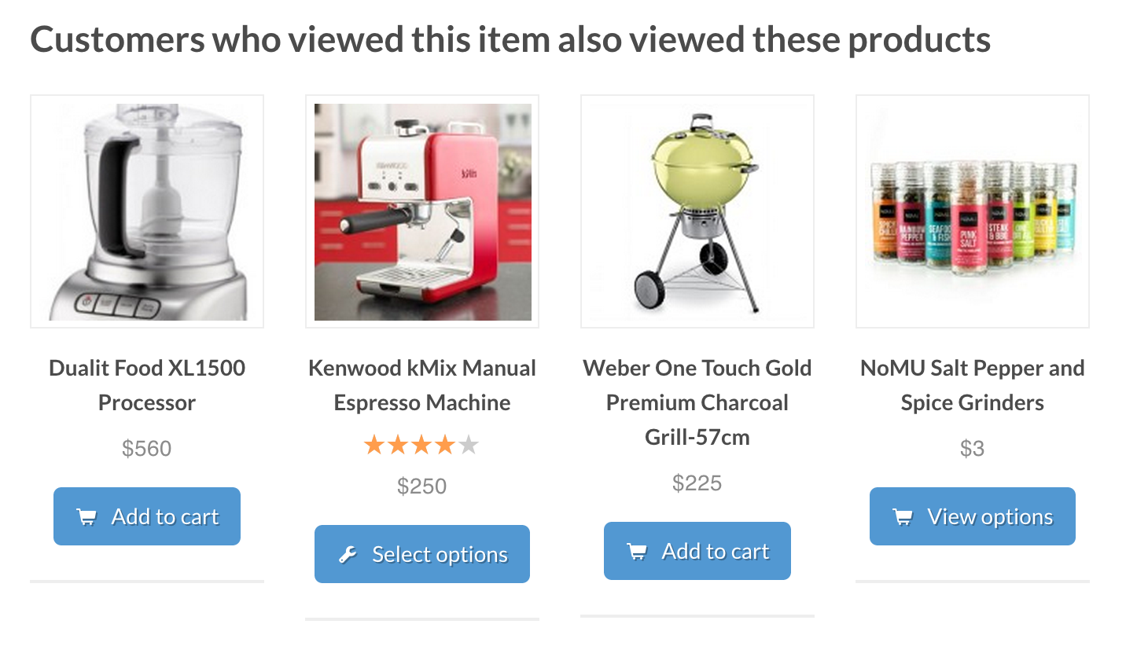




Recommendations based on Algorithms

Slide 9


Harrah’s Casino: Knowing your customer
Service provider of Gambling and Casinos
Entry Card
Pain points
Intervention
Reference: Supercrunchers
Notes:
for Lifetime Customer Value

Slide 10
What has been happening
1995
2005
2015
2025
Context: | Internet Web | Social Nets Recommend | Higher Accuracy Larger training | Control + AI Self learning
 | E-Commerce | Ad Driven Fin/Quant | Sharing Economy | ?

Slide 11
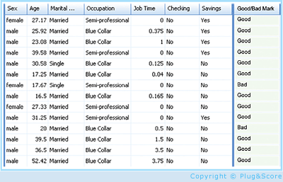
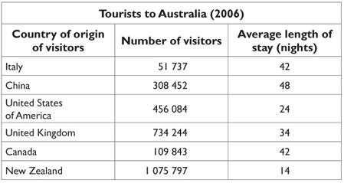
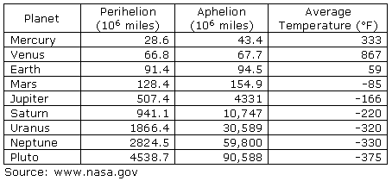
An ML High Level Framework
In Real Life
Features, but also loss of information
Some data has observed results
Objects
Events / Experiments
People / Customers
Products
Stocks
…
Person 1
Person 2
Person 3
.
.
.
Person N
In Sample
Out of Sample
- Characteristics
- Patterns
- Models
- Predictions
- Similarities
- Differences
- Distance

Slide 12
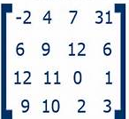
An ML High Level Framework
In Real Life
Features, but also loss of information
Some data has observed results
Objects
Events / Experiments
People / Customers
Products
Stocks
…
Person 1
Person 2
Person 3
.
.
.
Person N
In Sample
Out of Sample
- Characteristics
- Patterns
- Models
- Predictions
- Similarities
- Differences
- Distance
CS: Table
Math: Matrix X, with N rows – each person
m columns, each feature (age, salary, ..)
X =

Slide 13
A Fundamental Idea: From Table to N- Dimensional Space
Movie 2
Element | F1 | F2 | F3
A | 4 | 2 | 2
B | 4.5 | 1.5 | 3
C | 3 | 3 | 5
D | 1 | 2 | 2
E | 3 | 1.5 | 5
F | 3.5 | 3.5 | 1
.. | .. | .. | ..
Which user is closest to user A?
5
4
3
2
1
G
H
F
X =
D
C
A
B
E
1 2 3 4 5
Movie 1

Slide 14
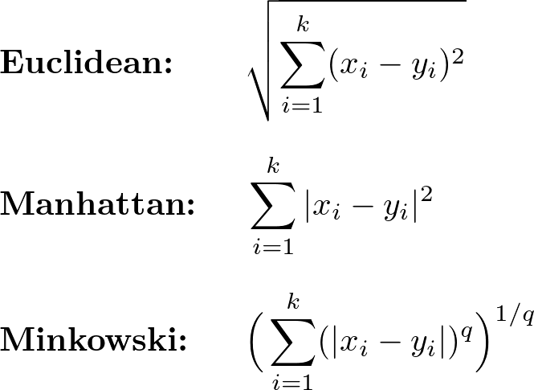
Clustering by Measuring Distance (Unsupervised)
Movie 2
Distance functions
5
4
3
2
1
G
H
F
D
C
A
E
B
Movie 1
1 2 3 4 5

Slide 15
Clustering to Classification
Feature 2
5
4
3
2
1
Target customers?
Pictures of Cats and Dogs
Speech recognition
Recognize Letters: A, B, C..
G
H
F
D
C
A
E
B
Feature 1
1 2 3 4 5
For Netflix: 70K -> 200K titles (dimensions), 10M plus users (points)
Factors: Accuracy vs Performance

Slide 16
A Fundamental Idea: From Table to Score
Cust | F1 | F2 | F3
A | 4 | 2 | 2
B | 4.5 | 1.5 | 3
C | 3 | 3 | 5
D | 1 | 2 | 2
E | 3 | 1.5 | 5
F | 3.5 | 3.5 | 1
.. | .. | .. | ..
Cust | Credit Score
A | 552
B | 381
C | 760
D | 330
E | 452
F | 678
.. | ..
F(X)
X =
X
Y

Slide 17
Machine Learning: Learning from Data
Input Data = Matrix X
Output Data = Column Vector Y
Customer 1: [Name, income, x, y, .. Features ..z]
Customer 2: [Name, income, x, y, .. Features ..z]
Customer N: [Name, income, x, y, .. Features ..z]
Customer 1: [20]
Customer 2: [60]
Customer N: [05]
Purchases/year, repaid loan, …
Target: What is F(X) = Y a formula that we don’t know
Sample data (training): (x1,y1) (x2,y2) … (xm,ym) we have this
Algorithm A from H
Find G(x) which is approx. F(x)
H: Hypothesis Set:
All possible algorithms or formulas
a) Supervised ML – as shown
b) Unsupervised - no training data
c) Reinforced learning – done by simulation

Slide 18
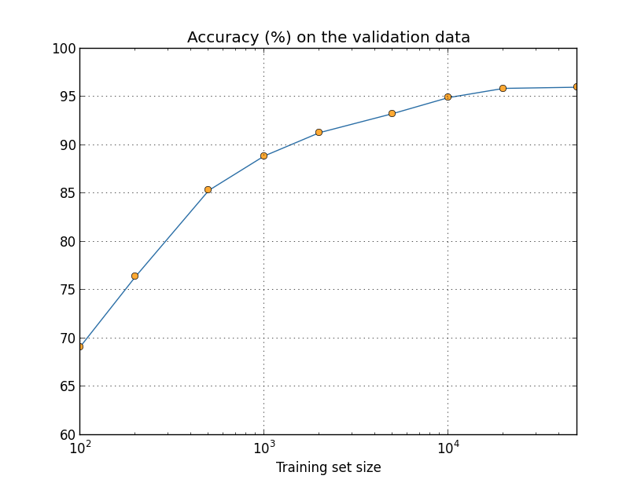

Slide 19

X
Y
X
Y

Slide 20
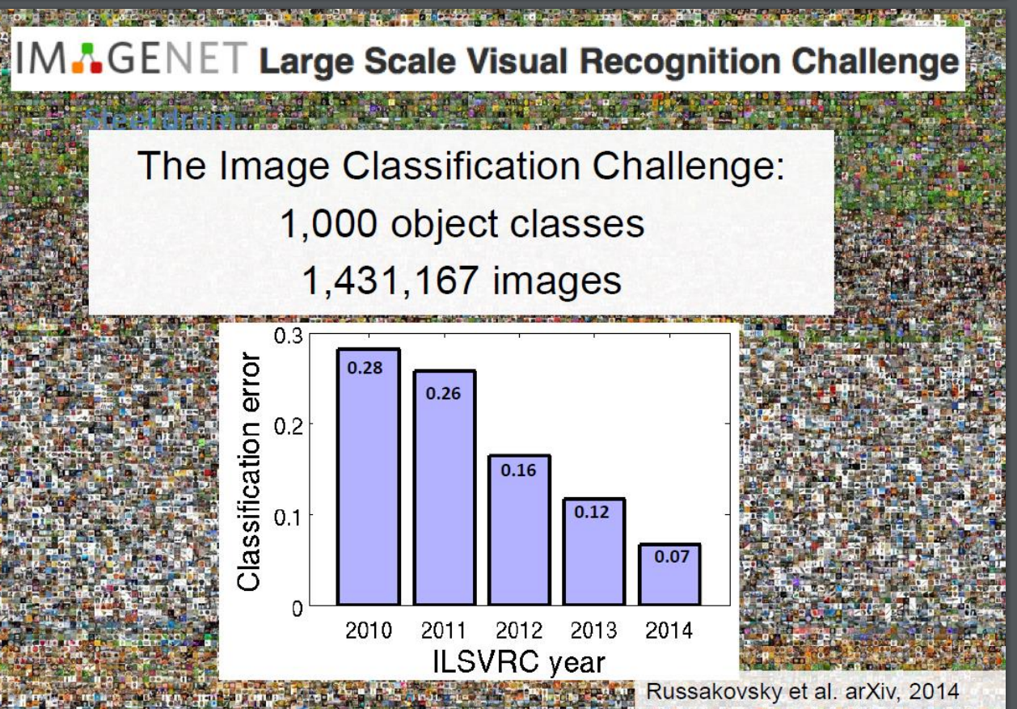
Neural net results are close to human results
The Key is multi-layer learning algorithms such as Deep Convolutional Neural Networks!

Slide 21
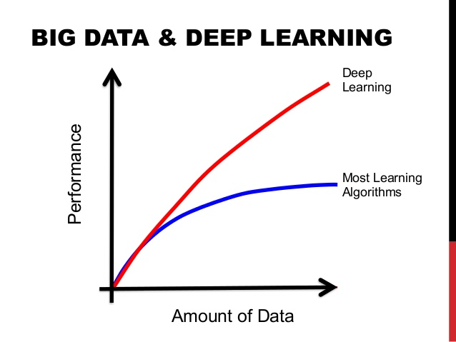
This means Accuracy

Slide 22
The Data-X System View
Possible Inputs Code Blocks
Possible Output Code Blocks
Compute including test, train, split
Web or Poll
Algorithm Options w/ Tables/Matrix
Prediction / Classification
Natural Language, State Space
Feature Extraction
Web
Download
Email
Stream
Social Net
Pandas: Short
Term Storage
Chatbot
…
…
Crawl
Long Term Storage: SQL and File Formats (JSON, CSV, Excel)
Control Decision
Feedback from External System (World)

Slide 23
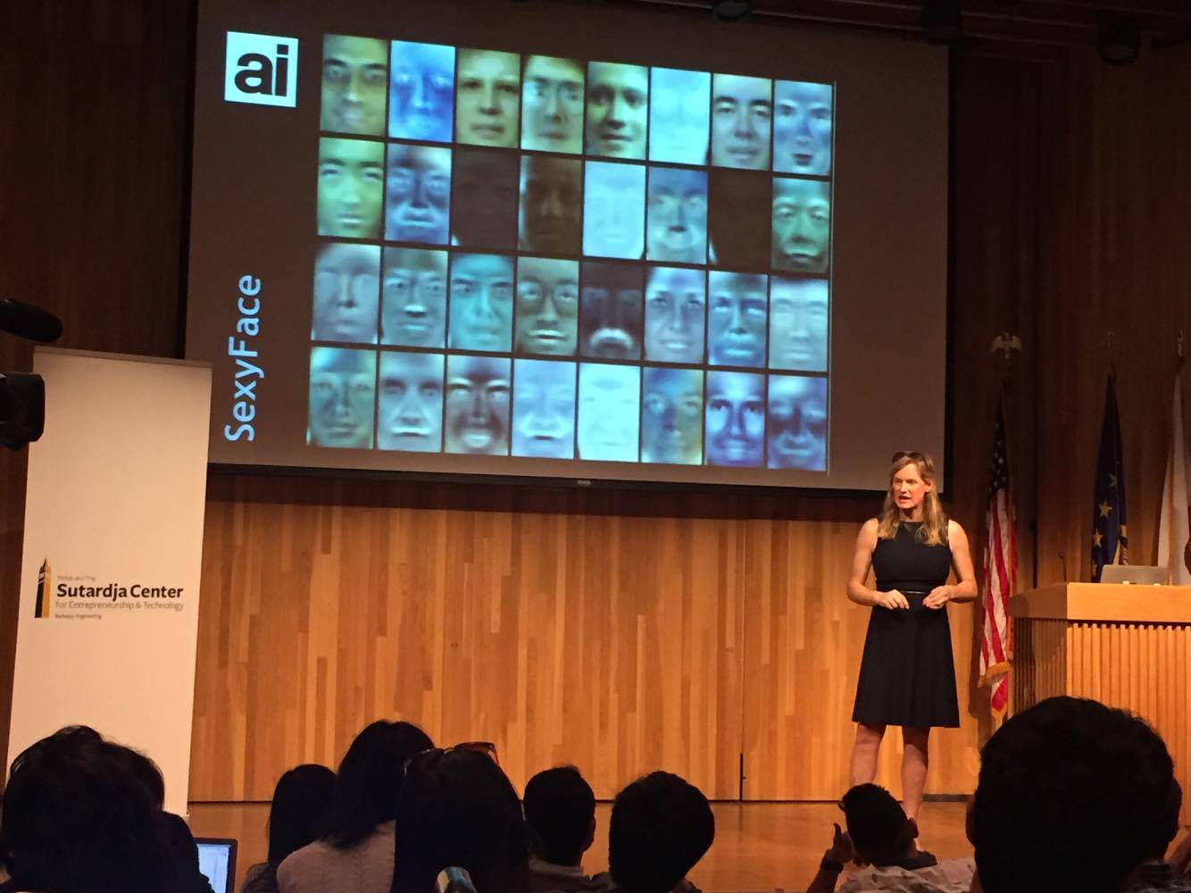
Vivienne Ming: Face Recognition for Finding Refugees in Camps

Slide 24






Top 8 Business Models Using Data
Knowing your customer, better targeting and relationship E.g. Target, Disney, Netflix
Improving physical product or servicer with complimentary information E.g. UPS, FedEx
Data-driven reliability or security E.g. GE, BMW, Siemens
Information Brokers, Arbitrage, and Trading Opportunities E.g. Investment funds.
Improving the customer journey/experience E.g. Harrah’s
Functional Applications: HR/Hiring, Operations etc. E.g. Walmart, Baseball, Sports
Efficiency or better performance per dollar cost E.g. General IT, SAP, etc
Risk Management, regulation, and compliance E.g. Compliance 360

Slide 25
Your Project Can also use a Data System for Social Impact
Financial inclusion
Health
Aid to underprivileged
Joining data for a research purpose
Justice
Environment
…

Slide 26
For Your Project – By Next week
Come up with 3 ideas for class projects in 1-3 sentences.
A systems or application you will build
Communicate: WHO the project is for, WHAT will it do, WHY this is needed/valuable.
Same instructions are in HW 1 Assignment

Slide 27
Reminder: A High Level Framework
In Real Life
Features, but also loss of information
Some data has observed results
Objects
Events / Experiments
People / Customers
Products
Stocks
…
Person 1
Person 2
Person 3
.
.
.
Person N
In Sample
Out of Sample
- Characteristics
- Patterns
- Models
- Predictions
- Similarities
- Differences
- Distance

Slide 28
A High Level Framework
In this class, we will learn ways to:
* Collect the data about objects
* Combine data sources when needed
* Use tables and databases to store
* Practice making good “features”
* Learn to Analyze; Compute, Classify, Predict
* Visualize some results
Use cookbook applications to get you started on your own applied project in a group.
In Real Life
Features, but also loss of information
Some data has observed results
Objects
Events / Experiments
People / Customers
Products
Stocks
…
Person 1
Person 2
Person 3
.
.
.
Person N
In Sample
Out of Sample
- Characteristics
- Patterns
- Models
- Predictions
- Similarities
- Differences
- Distance

Slide 29
End of Section

